Slide 1
Graphs Traversal
By:
Greg
2
23
3
9
S
18
14
6
2
6
30
4
19
15
5
11
5
6
20
16
7
T
44

Slide 2
Graph Traversals
→ visit all nodes in the graph (if graph is connected) from a root node.
Two basic graph-traversal algorithms
  Depth-First Search (DFS)
  Breadth-First Search (BFS)
KB 3 - Graph Traversal (DFS-BFS)

Slide 3
Depth-First Search (DFS)
Depth-first search (DFS) is a general technique for traversing a graph
A DFS traversal of a graph G
  Visits all the vertices and edges of G
  Determines whether G is connected
  Computes the connected components of G
  Computes a spanning tree of G
DFS can be further extended to solve other graph problems
  Find and report a path between two given vertices
  Find a cycle in the graph
KB 3 - Graph Traversal (DFS-BFS)

Slide 4
Example 1
A
unexplored vertex
visited vertex
A
A
A
A
A
A
A
A
A
A
unexplored edge
B
D
E
B
D
E
B
B
D
D
E
B
D
E
B
D
E
B
E
B
D
D
E
B
D
E
E
discovery edge
back edge
C
C
C
C
C
C
C
C
C
KB 3 - Graph Traversal (DFS-BFS)

Slide 5
Depth-First Search (DFS) Recursive
dfs(v:Vertex) {
mark v as visited
for (each vertex u adjacent to v)
if( ! visited(u) )
dfs(u)
}
KB 3 - Graph Traversal (DFS-BFS)

Slide 6
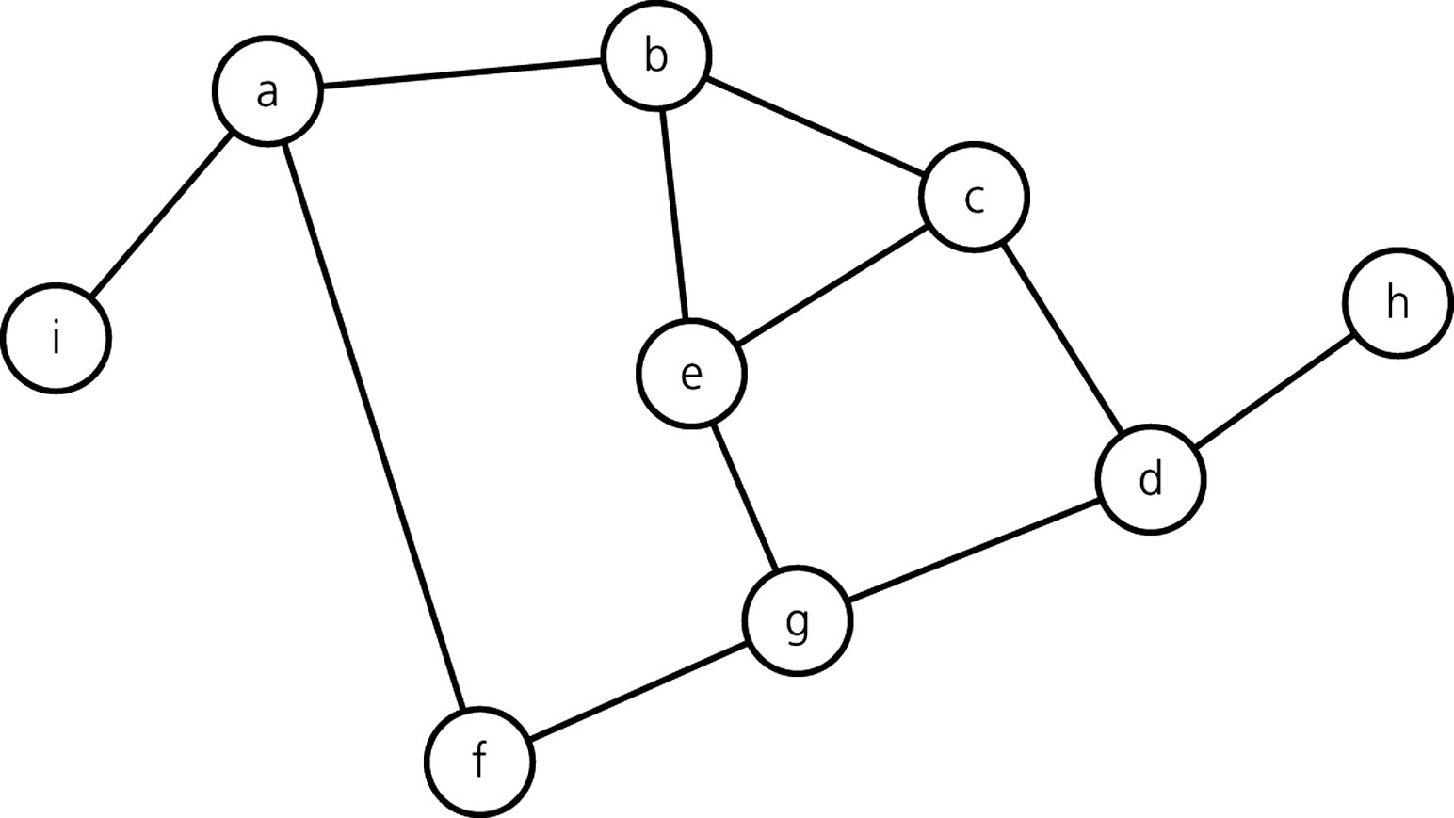
Practicing DFS Recursive
start
DFS-Recursive 0.2
KB 3 - Graph Traversal (DFS-BFS)

Slide 7

DFS and Maze Traversal
The DFS algorithm is similar to a classic strategy for exploring a maze
  We mark each intersection, corner and dead end (vertex) visited
  We mark each corridor (edge ) traversed
  We keep track of the path back to the entrance (start vertex) by means of a rope (recursion stack)
KB 3 - Graph Traversal (DFS-BFS)

Slide 8
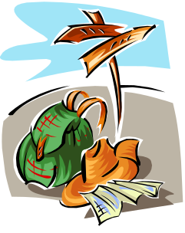

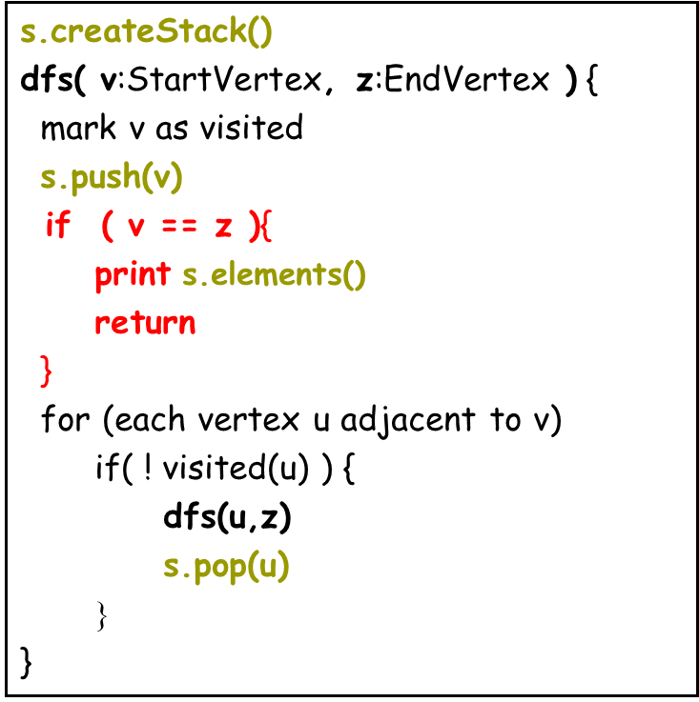
Path Finding
We can modified the DFS algorithm to find a path between two given vertices u and z
Call DFS() with u as the start vertex and z the end vertex
Use a stack S to keep track of the path between the start vertex and the current vertex
As soon as destination vertex z is encountered, we return the path as the contents of the stack
Raven_CoarseGraph
How The Cycle Finding?
KB 3 - Graph Traversal (DFS-BFS)

Slide 9
Iterative DFS Algorithm
dfs(in v:Vertex) {
s.createStack()
s.push(v)
mark v as visited
while( ! s.isEmpty() ){
if(no unvisited vertices are adjacent to the vertex
on the top of the stack)
s.pop()
else
select an unvisited vertex u adjacent to
the vertex on the top of the stack
s.push(u)
mark u as visited
}
}
KB 3 - Graph Traversal (DFS-BFS)

Slide 10
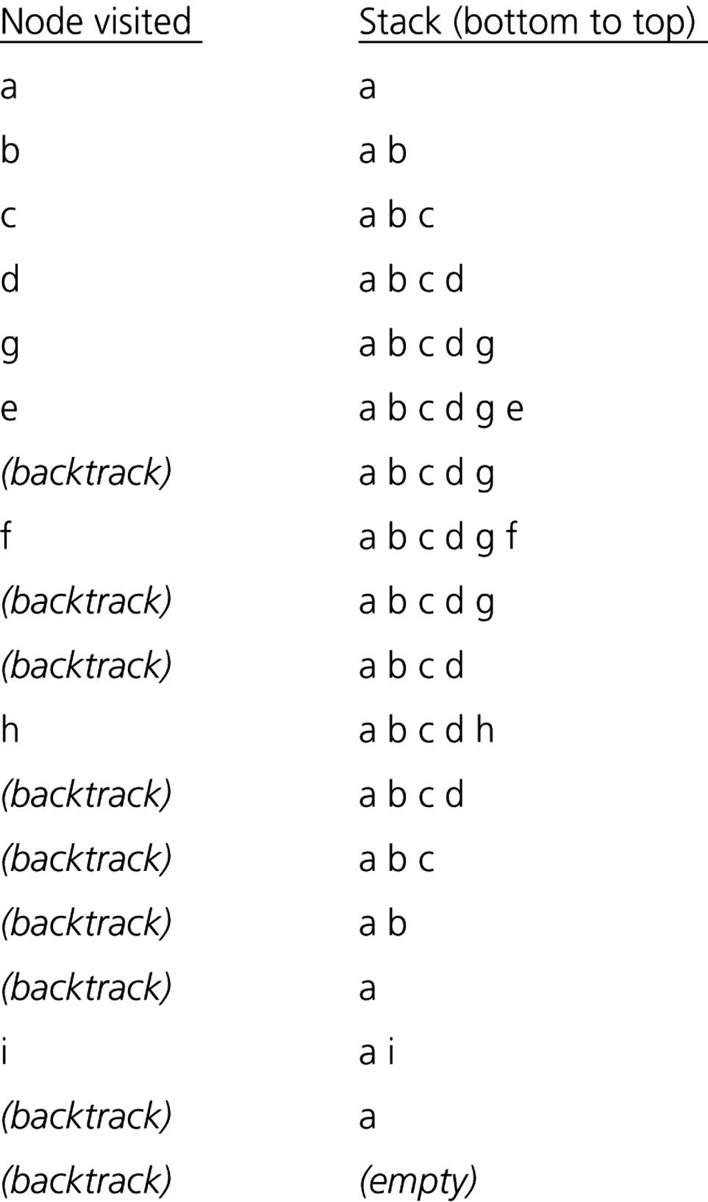
Iterative DFS Algorithm Example
DFS-Iterative 0.2
KB 3 - Graph Traversal (DFS-BFS)

Slide 11
Breadth-First Search (BFS)
Breadth-first search (BFS) is a general technique for traversing a graph
A BFS traversal of a graph G
  Visits all the vertices and edges of G
  Determines whether G is connected
  Computes the connected components of G
  Computes a spanning tree of G
BFS can be further extended to solve other graph problems
  Find and report a path with the minimum number of edges between two given vertices
  Find a simple cycle, if there is one
KB 3 - Graph Traversal (DFS-BFS)

Slide 12
Example 1
A
unexplored vertex
L₀
L₀
L₀
L₀
L₀
L₀
L₀
L₀
L₀
L₀
A
A
A
A
A
A
A
A
A
A
A
A
visited vertex
A
unexplored edge
L₁
L₁
L₁
L₁
L₁
L₁
L₁
L₁
L₁
B
C
D
B
B
B
B
C
C
C
C
D
D
D
B
C
D
B
D
B
B
B
C
C
C
C
D
D
D
B
D
B
C
C
D
discovery edge
D
cross edge
L₂
L₂
L₂
L₂
L₂
E
F
E
E
E
E
F
F
F
E
F
E
F
E
E
F
F
E
F
E
F
E
F
F
KB 3 - Graph Traversal (DFS-BFS)

Slide 13
BFS Algorithm
bfs(in v:Vertex) {
q.createQueue()
q.enqueue(v)
mark v as visited
while(!q.isEmpty())
{
q.dequeue(w)
for (each unvisited vertex u adjacent to w)
{
mark u as visited
q.enqueue(u)
}
}
}
KB 3 - Graph Traversal (DFS-BFS)

Slide 14
Iterative BFS Algorithm Application
start
BFS 0.1
KB 3 - Graph Traversal (DFS-BFS)

Slide 15
Spanning Trees and Spaning Forests
A spanning tree of a connected graph is a spanning subgraph that is a tree
A spanning tree is not unique unless the graph is a tree
Spanning trees have applications to the design of communication networks
A spanning forest of a graph is a spanning subgraph that is a forest
Graph
Spanning tree
KB 3 - Graph Traversal (DFS-BFS)

Slide 16
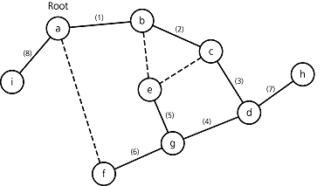

DFS Spanning Tree
KB 3 - Graph Traversal (DFS-BFS)

Slide 17
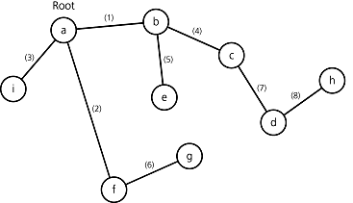

BFS Spanning Tree
KB 3 - Graph Traversal (DFS-BFS)

Slide 18
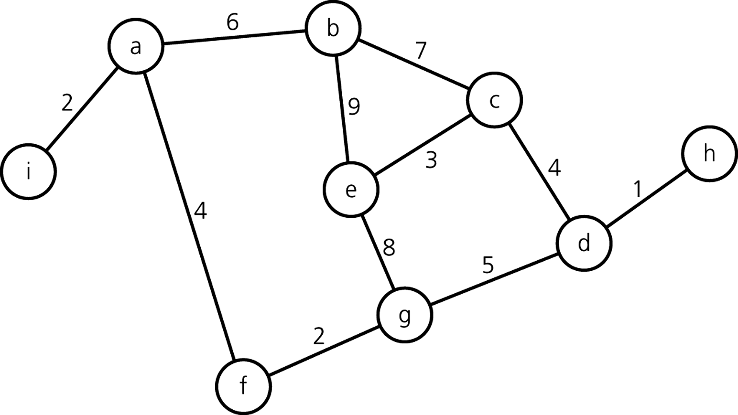
Minimum Spanning Tree (MST)
Assume the weight of an edge represents a cost value
What is the cheapest solution (tree) that connects all vertices?
KB 3 - Graph Traversal (DFS-BFS)

Slide 19
Minimum Spanning Tree (MST)
Prim's Algorithm
1. start at any vertex (= root)
2. mark root as visited and add it to the MST
3. while (there are still unvisited vertices) {
4. find the least-cost edge (v,u) from a visited
vertex v to some unvisited vertex u
5. mark u as visited
6. add vertex u and edge (v,u) to MST }
KB 3 - Graph Traversal (DFS-BFS)

Slide 20

MST Example
root
order of inclusion:
a
, i
, f
, g
, d
, h
, c
, e
, b
MST-Prims 0.2
KB 3 - Graph Traversal (DFS-BFS)

Slide 21
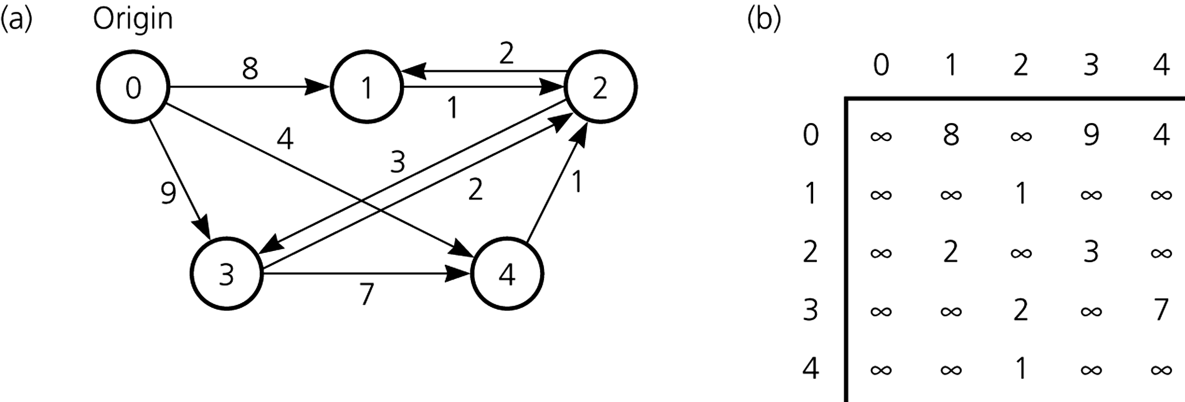

Shortest Path Tree (SPT)
Assume the weight of an edge represents a distance value
What are the shortest paths from one root to all other vertices?
KB 3 - Graph Traversal (DFS-BFS)

Slide 22
Shortest Path Tree (SPT)
Dijkstra’s Algorithm:
Input Parameter: Graph G, weight function w, root s
Dijkstra(G,w,s)
for each v ∈ V // V => All vertices in G
d[v] = ∞;
d[s] = 0; Q = V;
S = ∅; // S => Set of discovered vertex
while (Q ≠ ∅)
u = ExtractMin(Q);
S = S U {u};
for each v ∈ Adjacent[u]
if (d[v] > d[u]+w(u,v))
d[v] = d[u]+w(u,v);
Relaxation
Step
KB 3 - Graph Traversal (DFS-BFS)

Slide 23
Dijkstra’s Algorithm
No negative edge weights allowed
Similar to breadth-first search
  Grow a tree gradually, advancing from vertices taken from a queue
Also similar to Prim’s algorithm for MST
  Use a Priority Queue (PQ) keyed on d[v]
In a Priority Queue items must leave from the front, but they enter on the basis of a priority (key) value. The queue is kept sorted by this value.
Program Visualisasi\Dijkstra
KB 3 - Graph Traversal (DFS-BFS)

Slide 24
Dijkstra's Algorithm
1
∞
∞
4
5
B
D
4
1
1
∞
6
A
1
F
5
2
3
C
1
E
2
3
∞
∞
if all nodes are covered → FINISHED
select the node with smallest distance,
which is not yet in the set of covered nodes
add it to the set of covered nodes
shortest paths starting from node A
start out with source node (= root)
select the node with smallest distance,
which is not yet in the set of covered nodes
add it to the set of covered nodes
set up paths to all reachable nodes
update distances from root
update distances from root
update distances from root
set up paths to all reachable nodes
compute distances from root
select the node with smallest distance,
which is not yet in the set of covered nodes
add it to the set of covered nodes
set up paths to all reachable nodes
select the node with smallest distance,
which is not yet in the set of covered nodes
add it to the set of covered nodes
set up paths to all reachable nodes
KB 3 - Graph Traversal (DFS-BFS)

Slide 25
Shortest Path Tree
Easy ???
By inspection ???
KB 3 - Graph Traversal (DFS-BFS)

Slide 26
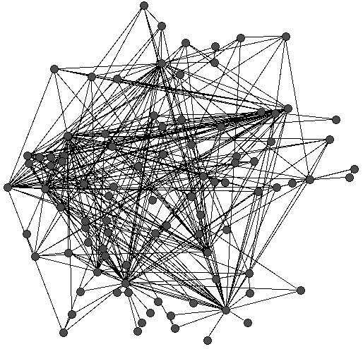
How about this one?
KB 3 - Graph Traversal (DFS-BFS)

